Slide 1
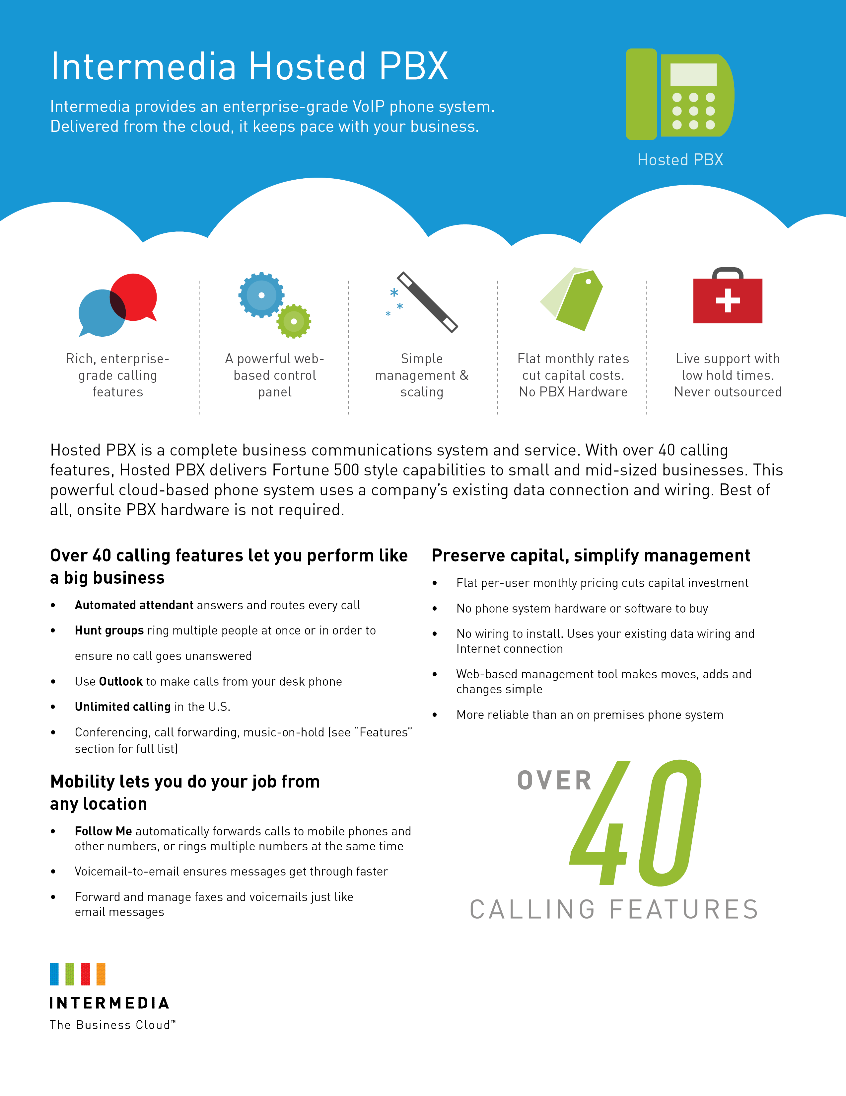
Seeley Technology
Get started with Hosted PBX today!
CALL US
980.533.8053
EMAIL US
service@seeley.tech
ON THE WEB
www.seeley.tech

Slide 2
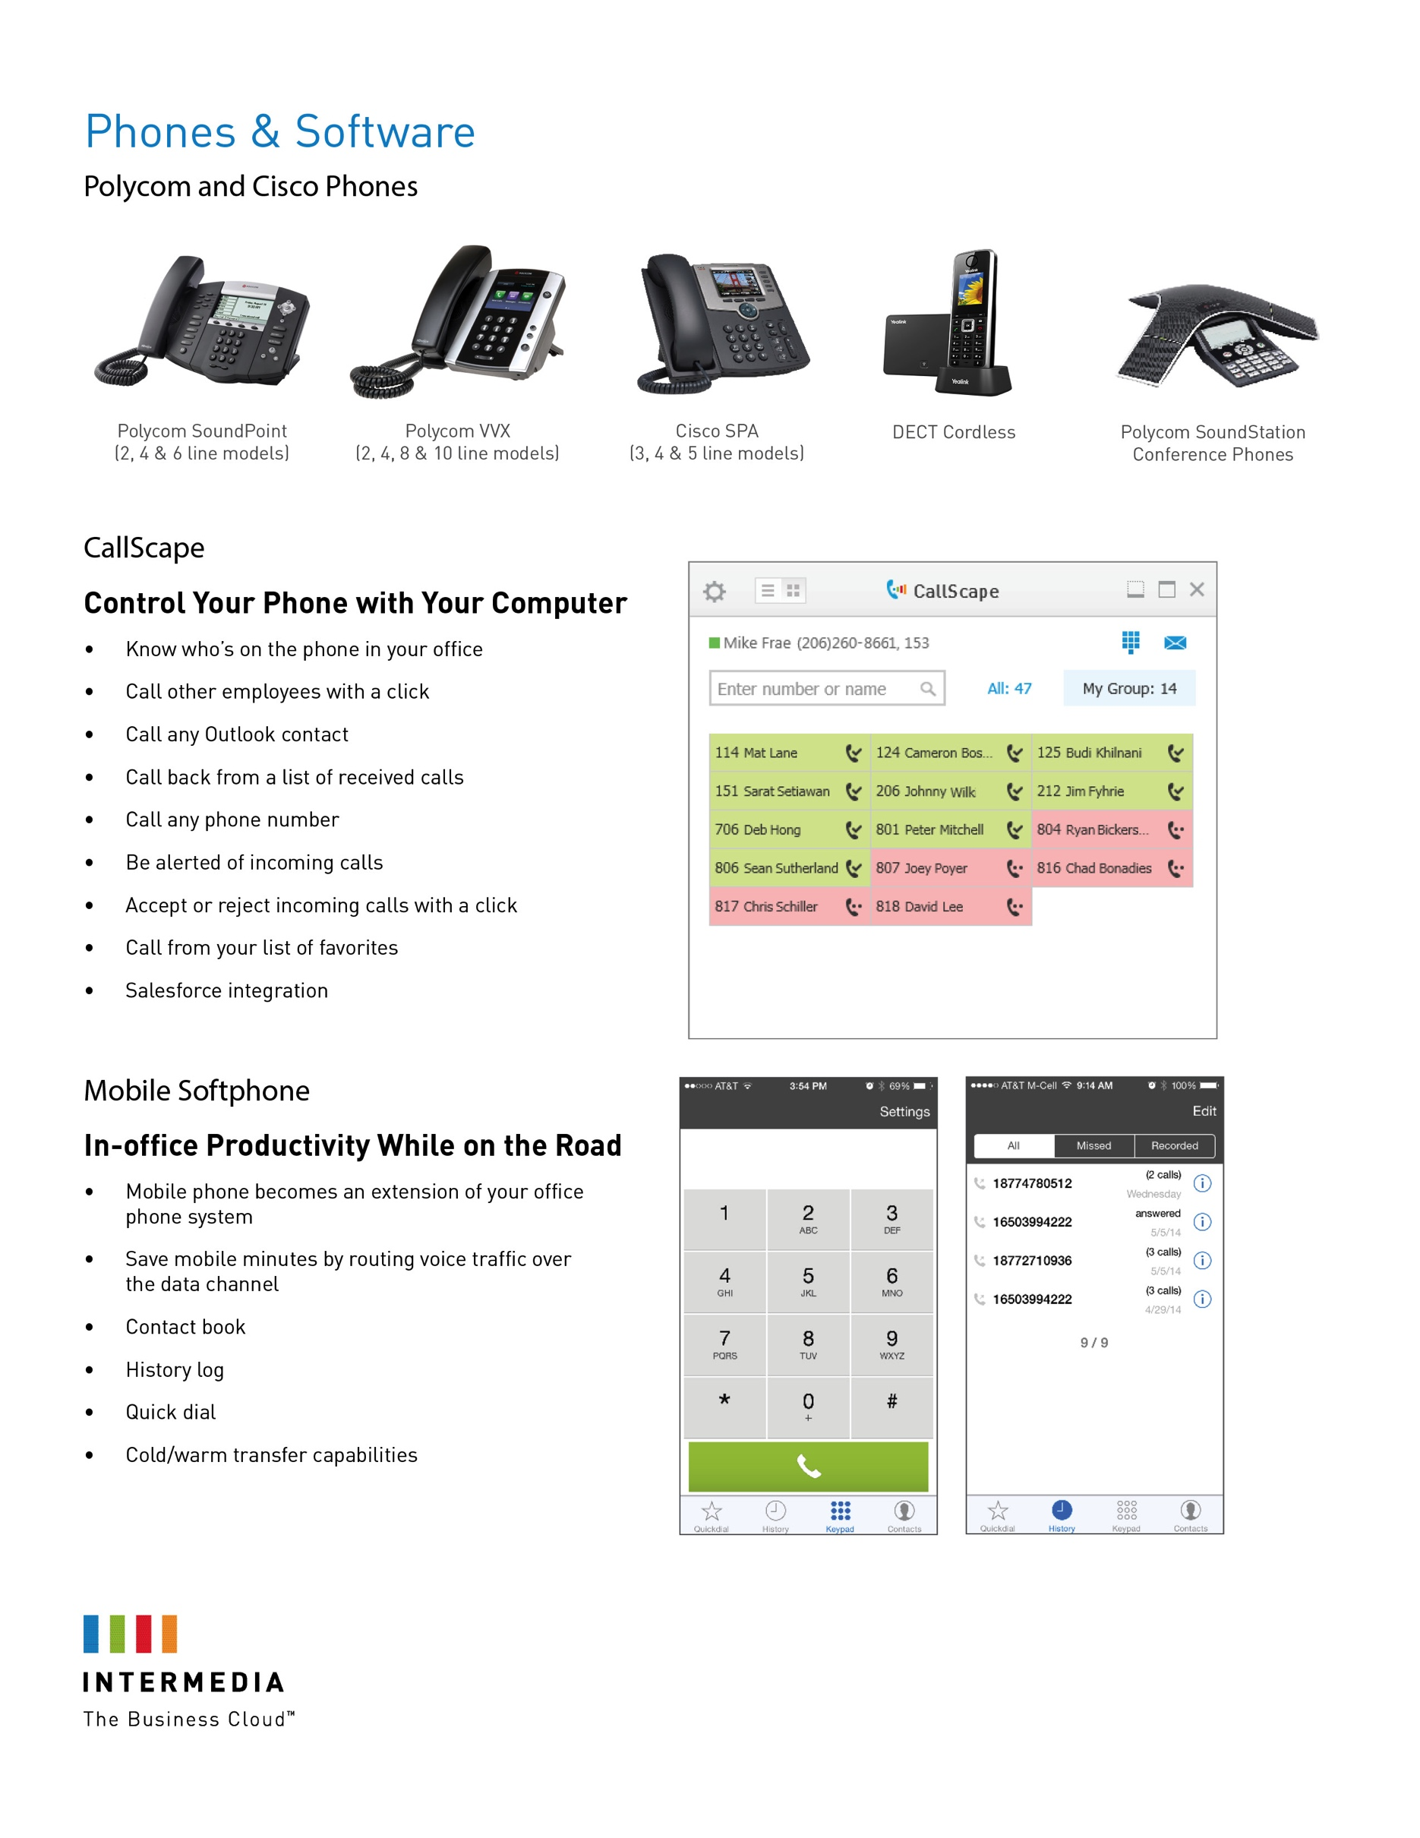
Seeley Technology
Get started with Hosted PBX today!
CALL US
980.533.8053
EMAIL US
service@seeley.tech
ON THE WEB
www.seeley.tech

Slide 3

Seeley Technology
Get started with Hosted PBX today!
CALL US
980.533.8053
EMAIL US
service@seeley.tech
ON THE WEB
www.seeley.tech

